Slide 1
Customer support Automation of ticket creation (RPA)
PIP2001 Capstone Project
Review-0
Batch Number: 2021-2025
Under the Supervision of,
Prof. PALLAVI R
Professor School of Computer Science and Engineering
Presidency University
Roll Number | Student Name
202211LIT0002 20211IST0009 20211IST0022 20211IST0001 | Sameer Chirag Arsalan Ali Khan Rakesh K
Name of the Program: Information Science And Technology
Name of the HoD: Dr. Pallavi
Name of the Program Project Coordinator:
Name of the School Project Coordinators: Dr. Sampath A K / Dr. Abdul Khadar A / Mr. Md Ziaur Rahman

Slide 2
Content
Problem Statement
Analysis of Problem Statement
Timeline of the Project
References

Slide 3
Problem Statement Number:
Organization: KG Into Systems Pvt Ltd
Category (Hardware / Software / Both) : Software
Problem Description:Manual ticket creation in customer support often presents significant challenges, including increased processing time, higher error rates, and inconsistent data handling. These issues can lead to delayed responses, customer dissatisfaction, and inefficiencies within support teams. The problem is compounded by the need for support agents to handle repetitive tasks that could be automated, diverting their focus from more complex and value-added activities.
Difficulty Level: Complex

Slide 4
Analysis of Problem Statement
Technology Stack Components:
Increased Processing Time
Higher Error Rates
Inconsistent Data Handling
Diverted Focus
Integration Issues
Operational Inefficiencies

Slide 5
Analysis of Problem Statement (contd...)
Software Requirment:
Ticketing System Integration: CRM Integration, Support Channels Integration
Automation Engine:Rule-based Engine, Natural Language Processing (NLP)
User Interface:Agent Dashboard, Admin Dashboard
Data Management:Database System, Data Security
Reporting and Analytics:Reporting Tools, Analytics Engine
Integration and APIs:APIs, Webhooks
Notification System:Alerts and Notifications
Scalability:Load Balancing, Microservices Architecture

Slide 6
Analysis of Problem Statement (contd...)
Hardware Requirment:
Servers and Infrastructure:Web Servers, Application Servers, Database Servers
Networking:High-Speed Internet, Load Balancers
Storage:Data Storage
Backup and Recovery:Backup Systems, Disaster Recovery
Security:Firewalls and Intrusion Detection Systems, VPNs

Slide 7
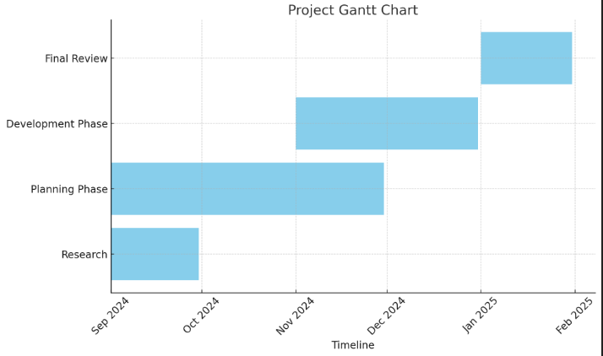
Timeline of the Project (Gantt Chart)

Slide 8
References (IEEE Paper format)
Zendesk Blog: Article: Automating Customer Support: Benefits and Best Practices
Freshdesk Blog:Article: How to Automate Your Customer Support
ServiceNow Documentation:Page: Automating Ticket Management with ServiceNow
Zendesk Case Studies:Case Study: How Automating Support Helped Rothy's Scale
Freshdesk Case Studies:Case Study: How Instacart Improved Support Efficiency with Freshdesk

Slide 9


